Slide 1
WATER QUALITY DATA ANALYTICS
CREATEDBY–MANJIMA BHATTACHARYYA (DAZZLE)

Slide 2
AGENDA
SL.NO | CONTENTS
1 | PROBLEM STATEMENT
2 | PROJECT OVERVIEW
3 | WHY WE NEED THIS
4 | SOLUTION
5 | MODELLING (ANALYSIS MODEL)AND VISUALISATION
6 | LIVE DEMO – ANALYSIS DASHBOARD
7 | RESULT(PREDICTION MODEL)
8 | THANKS

Slide 3
PROBLEM STATEMENT
Water is essential for our life . From a view ,many factors are affects in quality of water , so I choose water quality analysis in machine learning .
Only 3 % of Earth's water is fresh water. 1 % of this fresh water is fit for drinking.
My research is to testing water quality like ph, Turbidity (NTU), Temperature (°C), Dissolved Oxygen (mg/L),etc. Then I analyze the data .

Slide 4
PROJECT OVERVIEW
My goal is to check the quality of water. As per normal water parameter , in my dataset I have to check all of the parameter of water .
So I started in jupyter notebook and gathered data, filtered it, then moved on to visualization, and eventually created a prediction model for this data set.

Slide 5
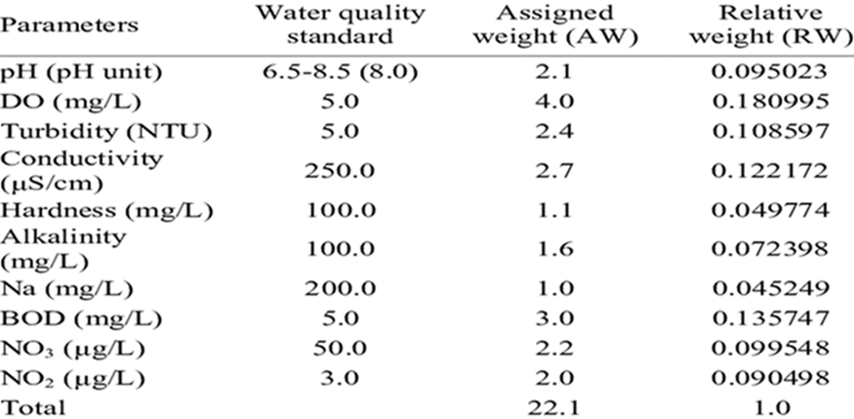
WHY WE NEED THIS?
As per normal water parameter in our dataset we have to check all of the parameter of water . we need to check the quality of water is good or not because Only 3 % of Earth's water is fresh water.
As normal water parameter are -

Slide 6
HOW IT HELP PEOPLE?
Parameters that are frequently sampled or monitored for water quality include temperature, dissolved oxygen, pH, conductivity, ORP, and turbidity. However water monitoring may also include measuring total algae, ISEs (ammonia, nitrate, chloride), or laboratory parameters.
It help people to understand the quality of water is good or bad and also its safe or not. It also help people in agriculture, industry, and electricity etc.

Slide 7
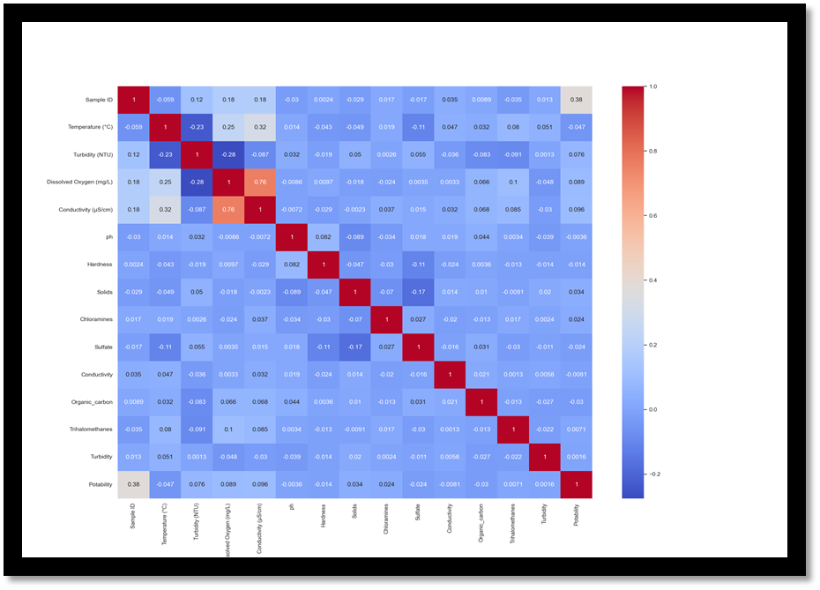
SOLUTION
Address the quality and sustainability of water resources, which are critical to the survival of people and the planet. So we have to check the quality of water for every thing.

Slide 8
MODELLING (ANALYSIS MODEL)AND VISUALISATION
Take csv file
Then CSV File give full information
Then we take of backup of csv file
Then we analyze & prediction the data
Then we get result

Slide 9
WHO ARE THE END’S USER?
Industrialization
Household Needs
Agriculture
For hydro-electricity generation
For cooking purpose.
For feeding plants.

Slide 10
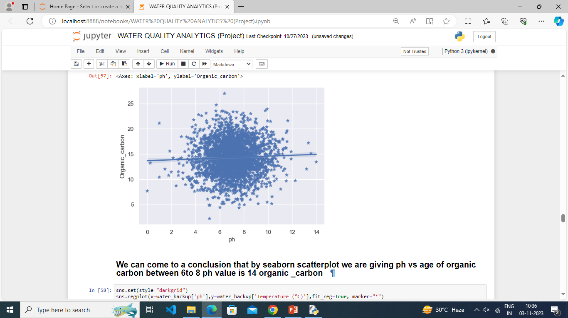
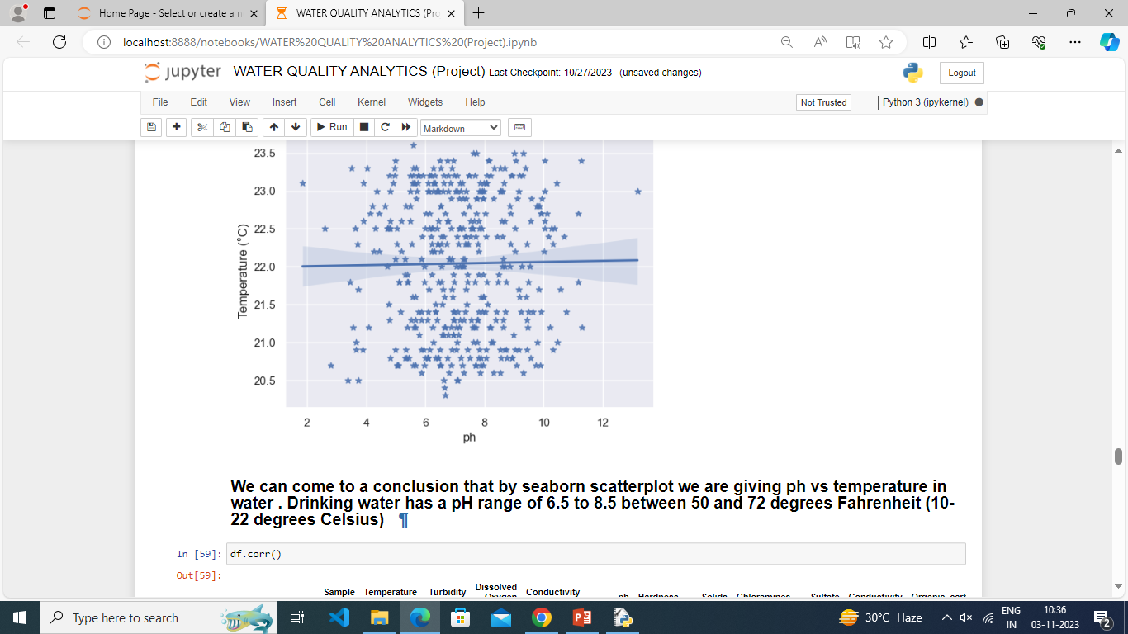
RESULT(PREDICTION MODEL)

Slide 11
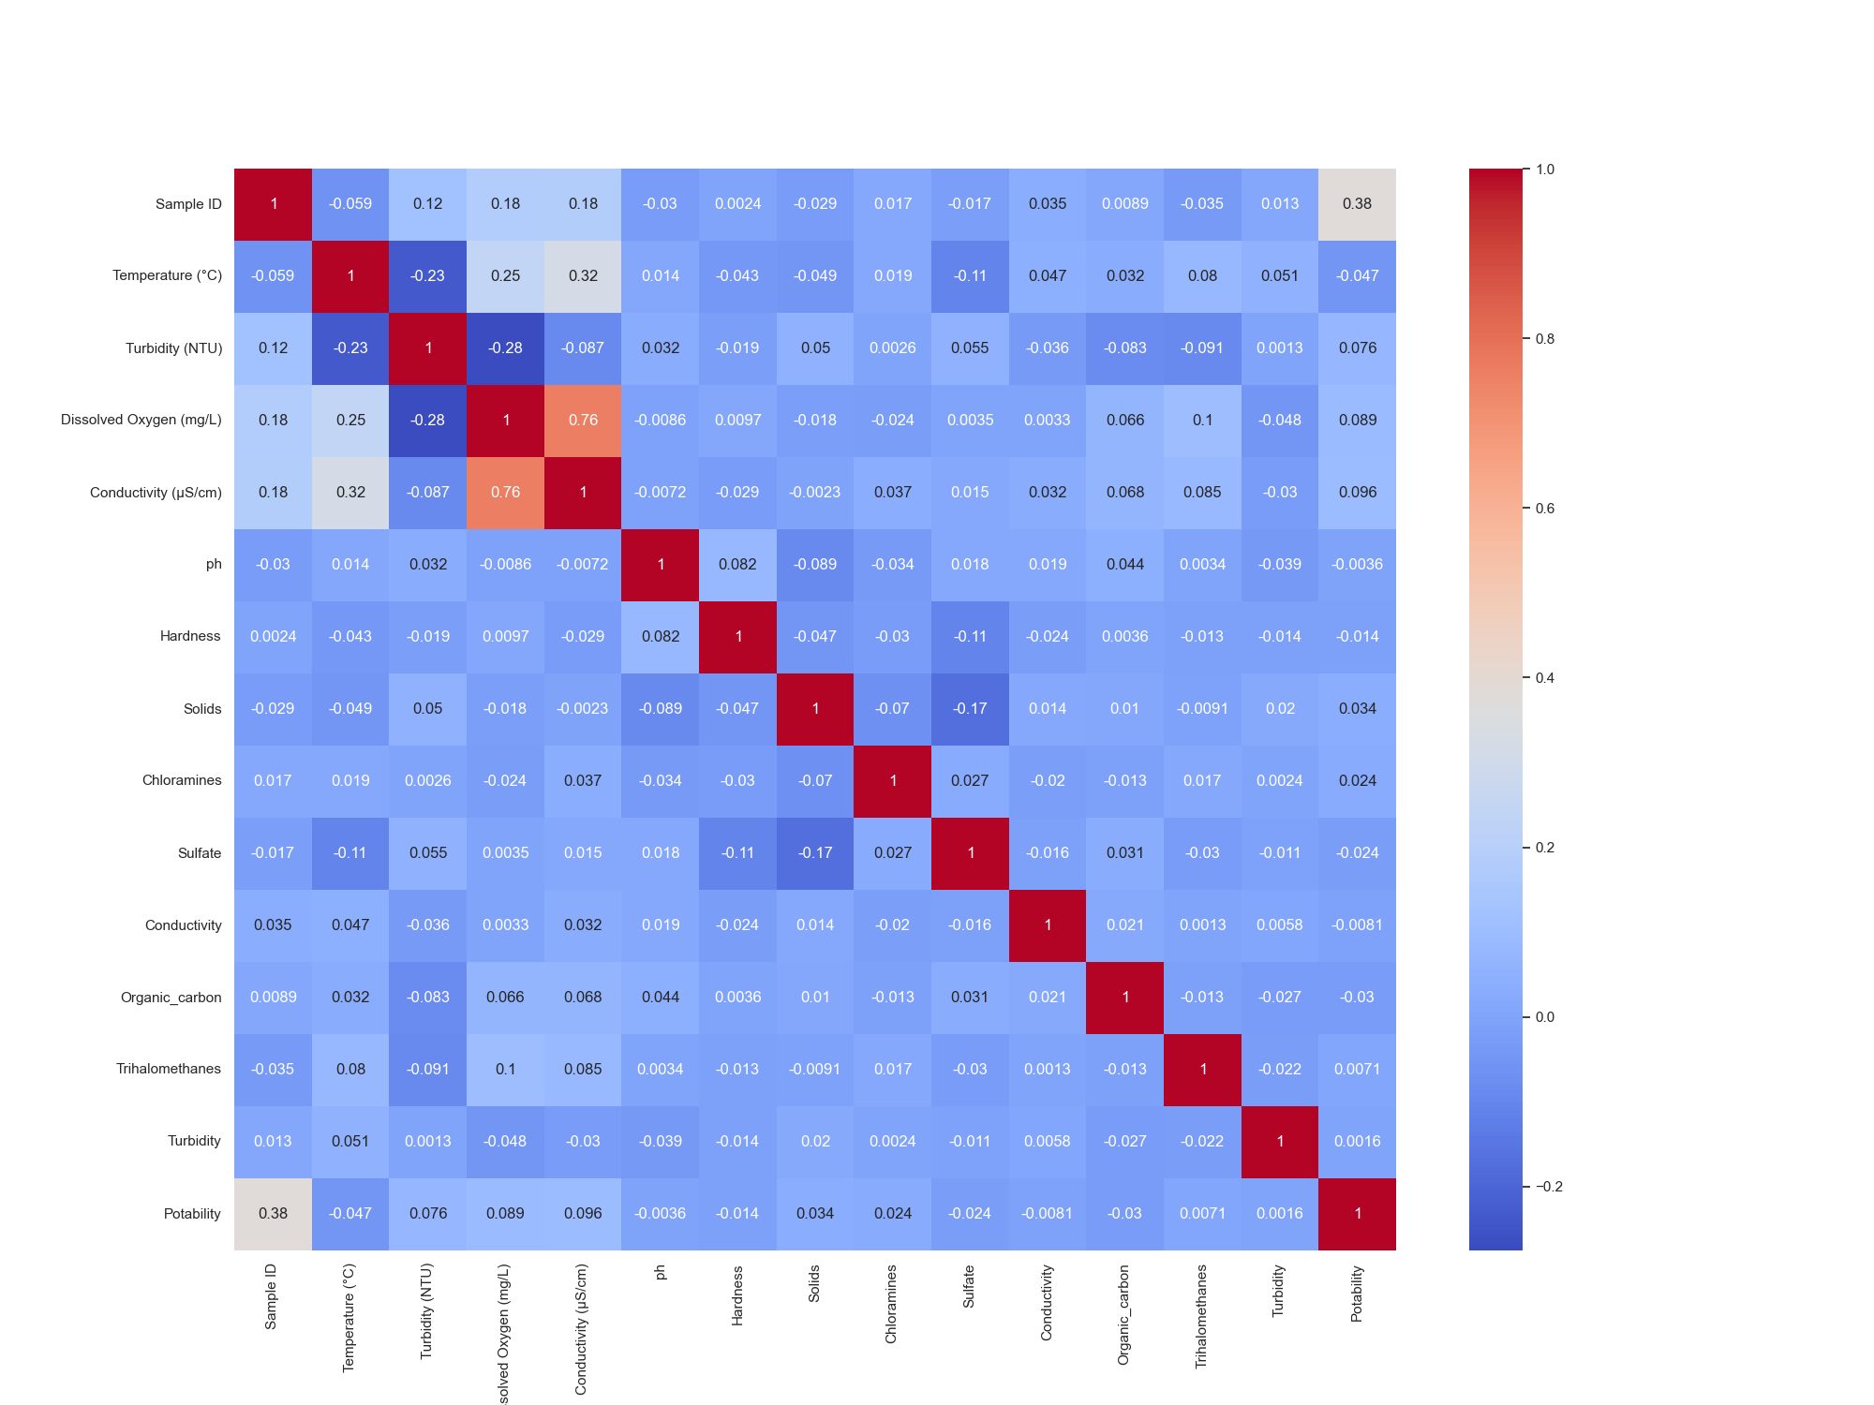
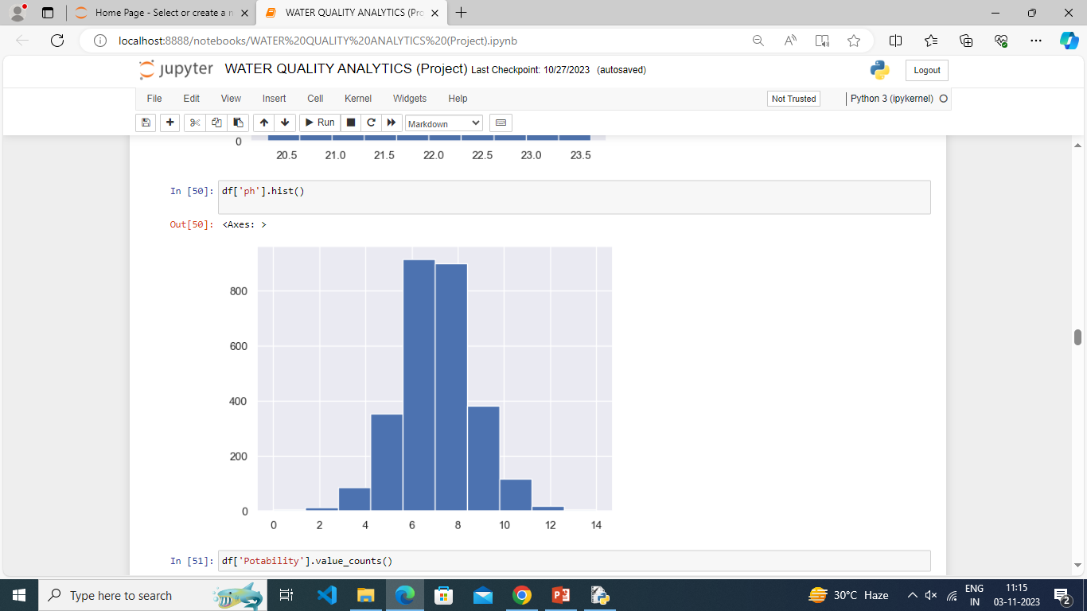
RESULT(PREDICTION MODEL) (cont.)

Slide 12
LIVE DEMO
https://github.com/Manjima04/DAZZLE.git

Slide 13
THANK YOU
GUIDED BY-MS.ARPITA MAM

